Slide 1

Problem Workshop I: SU² as a High-fidelity Analysis Tool
SU² Release Version 2.0 Workshop
Stanford University
Tuesday, January 15th, 2013
Thomas D. Economon
Department of Aeronautics & Astronautics
Stanford University

Slide 2

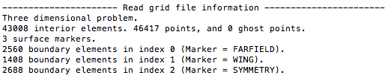
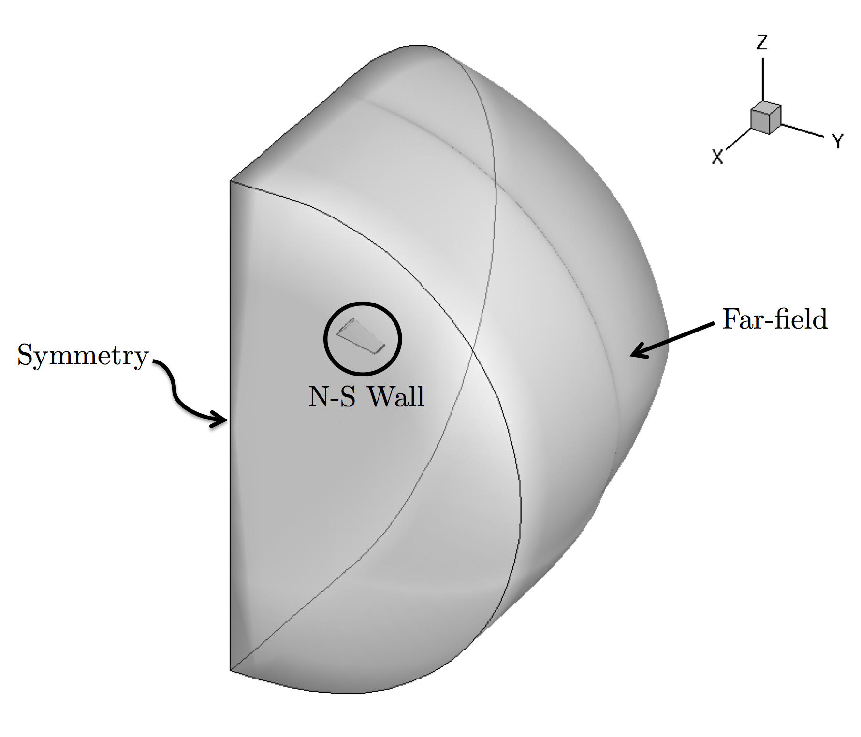
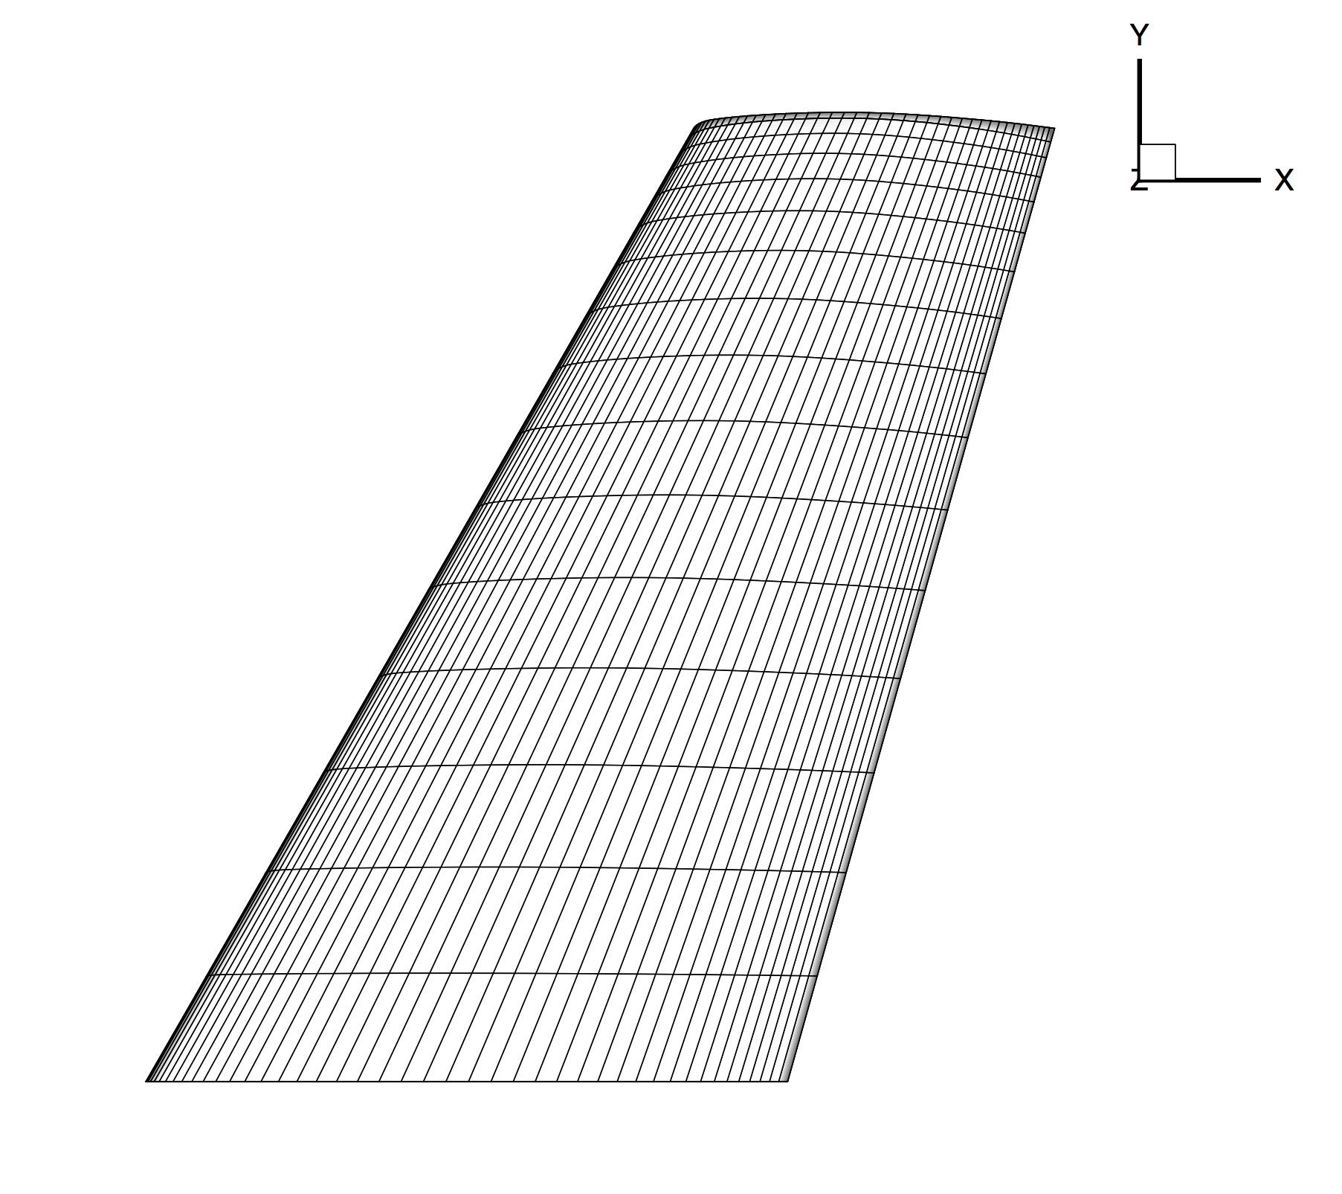
ONERA M6 RANS Analysis
Prepare geometry & mesh beforehand.
Choose appropriate physics.
Set proper conditions for a viscous simulation.
Select numerical methods:
Convective terms
Viscous terms
Time Integration
Multi-grid
Run the analysis.
Post-process the results.
Notes:
- Must have a way to get geometry and a mesh (ie Pointwise)
we’ll be using the ONERA M6 a an example of high-fidelity simulation
Meshes have markers to name BCs
- note that ‘viscous’ meshes need the appropriate number of nodes near the wall to resolve the boundary layer

Slide 3
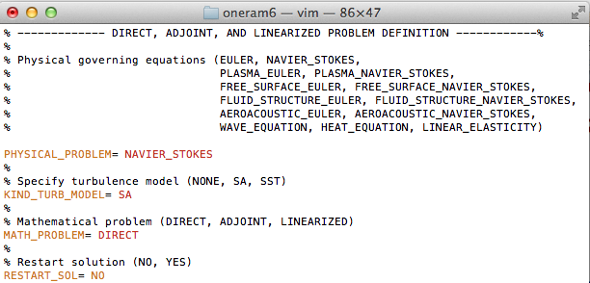
ONERA M6 RANS Analysis
Prepare geometry & mesh beforehand.
Choose appropriate physics.
Set proper conditions for a viscous simulation.
Select numerical methods:
Convective terms
Viscous terms
Time Integration
Multi-grid
Run the analysis.
Post-process the results.
Notes:
We have lots of options for equation sets, and you can create your own too
For this, we will be using the Navier-Stokes equations w/ a turb model (highest level)
- we’re working on other turb models (SST), and if you set this to no, you get laminar N-S

Slide 4
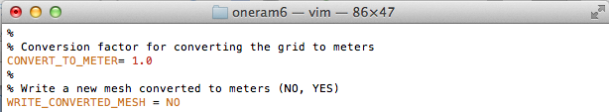
ONERA M6 RANS Analysis
Prepare geometry & mesh beforehand.
Choose appropriate physics.
Set proper conditions for a viscous simulation.
Select numerical methods:
Convective terms
Viscous terms
Time Integration
Multi-grid
Run the analysis.
Post-process the results.
Store the gas constants and freestream temperature, then calculate the speed of sound.
Calculate and store the freestream velocity from the Mach number & AoA/sideslip angles.
Compute the freestream viscosity from Sutherland's law and the supplied freestream temperature.
Use the definition of the Reynolds number to find the freestream density from the supplied Reynolds information, freestream velocity, and freestream viscosity from step 3.
Calculate the freestream pressure using the perfect gas law with the freestream temperature, specific gas constant, and freestream density from step 4.
Perform any required non-dim.
Notes:
Supply Mach, freestream angles, Temperature, Re, Re length (grid must be in meters!)
- ignore the freestream pressure
- make sure to mention grid conversion

Slide 5
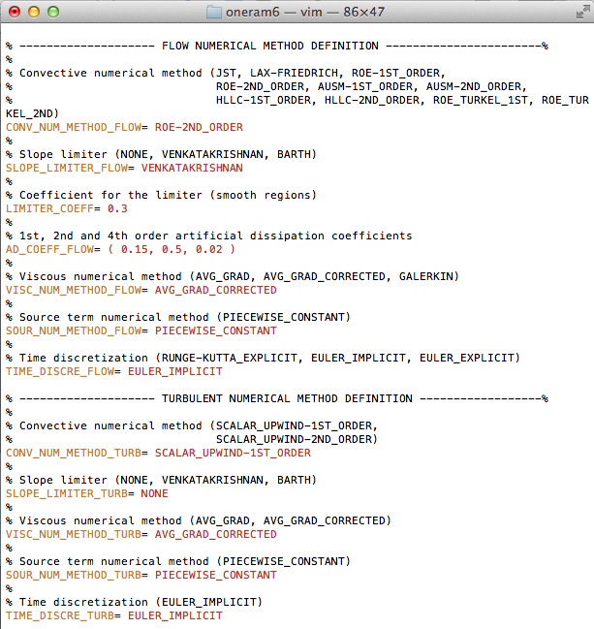
ONERA M6 RANS Analysis
Prepare geometry & mesh beforehand.
Choose appropriate physics.
Set proper conditions for a viscous simulation.
Select numerical methods:
Convective terms
Viscous terms
Time Integration
Multi-grid
Run the analysis.
Post-process the results.
Notes:
Note we have to fill out two sections bc we are using a turb model as well, which has it’s own numerics class
- all upwinding here

Slide 6
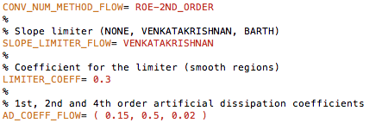

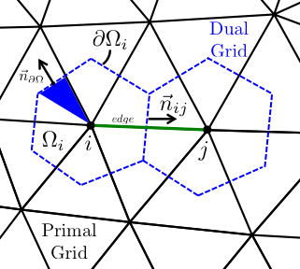
ONERA M6 RANS Analysis
Prepare geometry & mesh beforehand.
Choose appropriate physics.
Set proper conditions for a viscous simulation.
Select numerical methods:
Convective terms
Viscous terms
Time Integration
Multi-grid
Run the analysis.
Post-process the results.
Notes:
Note we have to fill out two sections bc we are using a turb model as well, which has it’s own numerics class
- all upwinding here
- REFERENCE VALUES!

Slide 7
ONERA M6 RANS Analysis
Prepare geometry & mesh beforehand.
Choose appropriate physics.
Set proper conditions for a viscous simulation.
Select numerical methods:
Convective terms
Viscous terms
Time Integration
Multi-grid
Run the analysis.
Post-process the results.

Slide 8


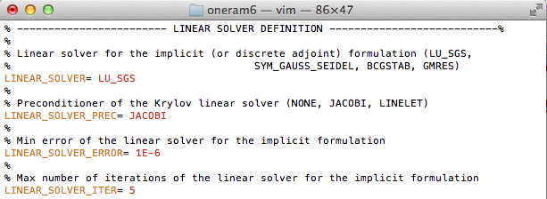
ONERA M6 RANS Analysis
Prepare geometry & mesh beforehand.
Choose appropriate physics.
Set proper conditions for a viscous simulation.
Select numerical methods:
Convective terms
Viscous terms
Time Integration
Multi-grid
Run the analysis.
Post-process the results.

Slide 9
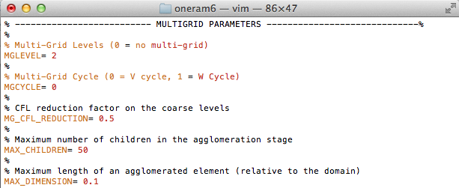
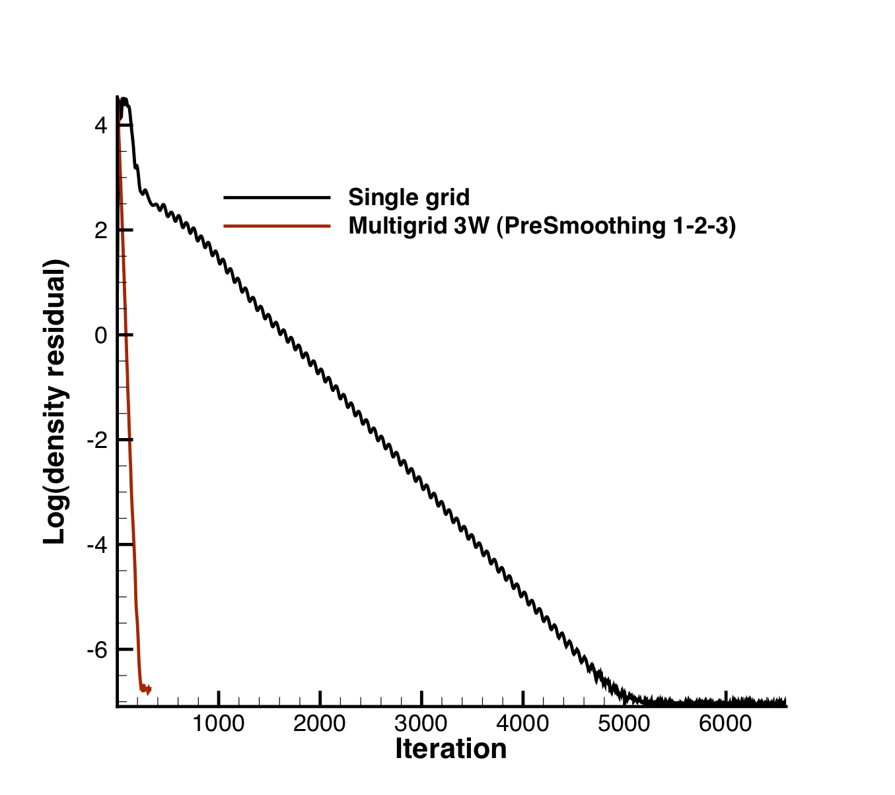
ONERA M6 RANS Analysis
Prepare geometry & mesh beforehand.
Choose appropriate physics.
Set proper conditions for a viscous simulation.
Select numerical methods:
Convective terms
Viscous terms
Time Integration
Multi-grid
Run the analysis.
Post-process the results.
(Inviscid ONERA M6)

Slide 10


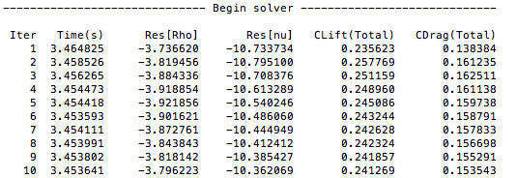
ONERA M6 RANS Analysis
Prepare geometry & mesh beforehand.
Choose appropriate physics.
Set proper conditions for a viscous simulation.
Select numerical methods:
Convective terms
Viscous terms
Time Integration
Multi-grid
Run the analysis.
Post-process the results.

Slide 11
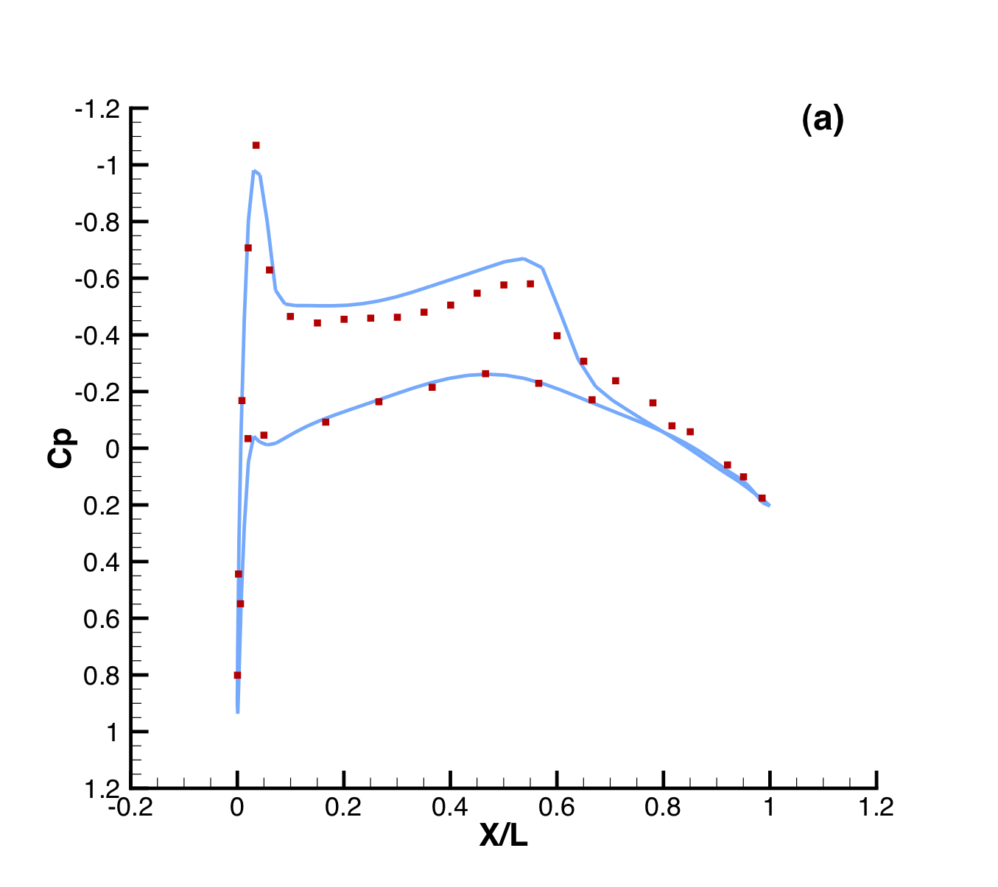
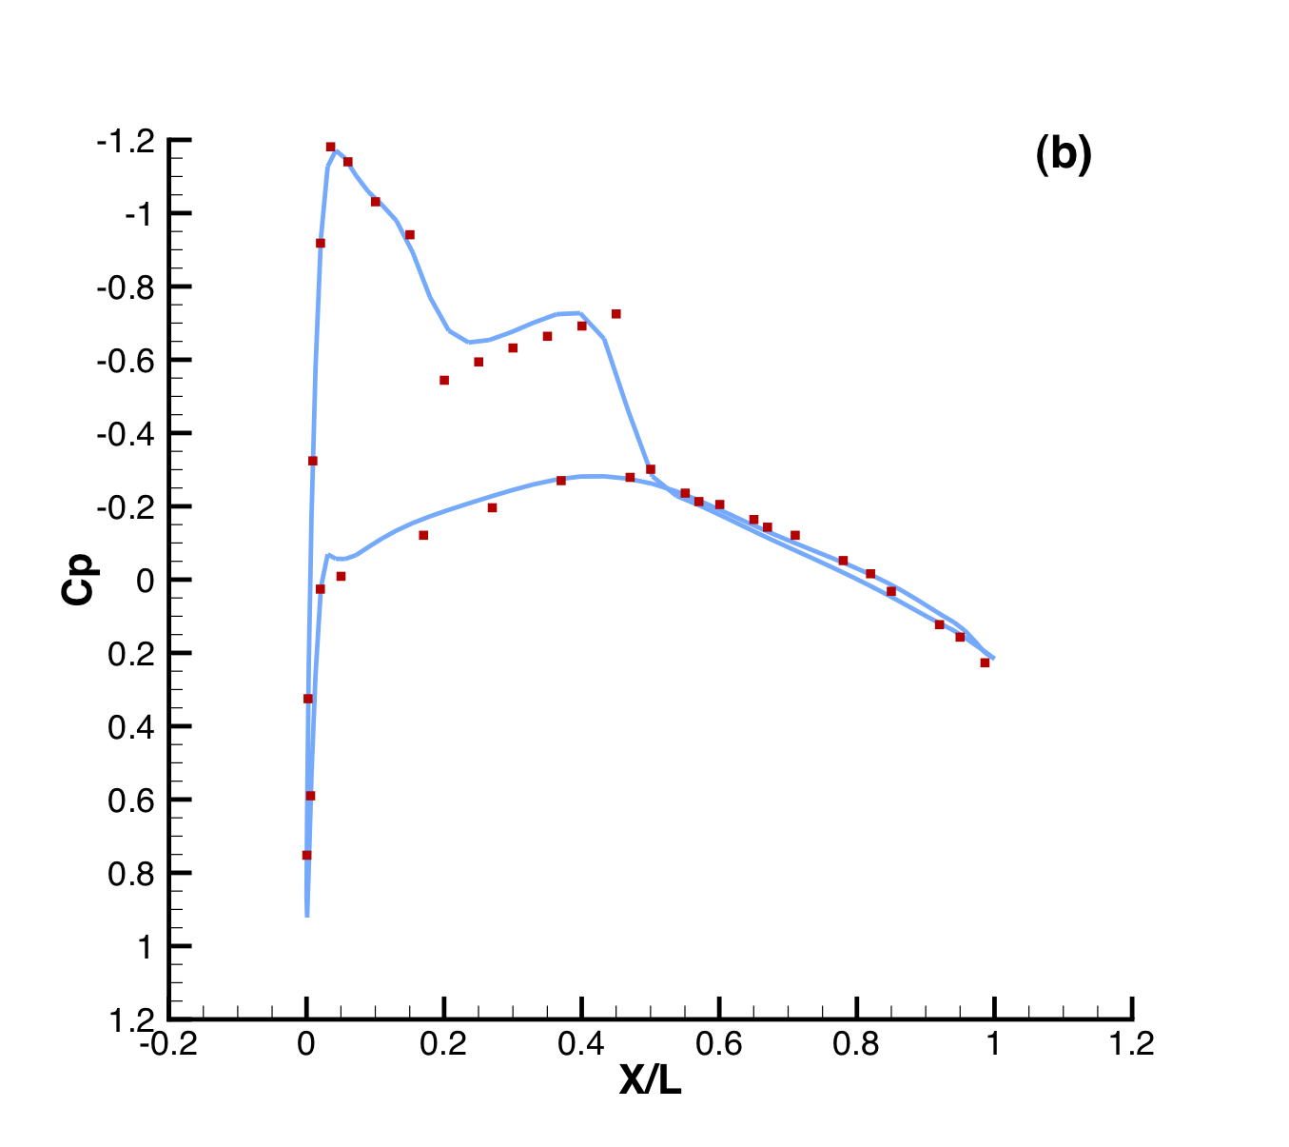
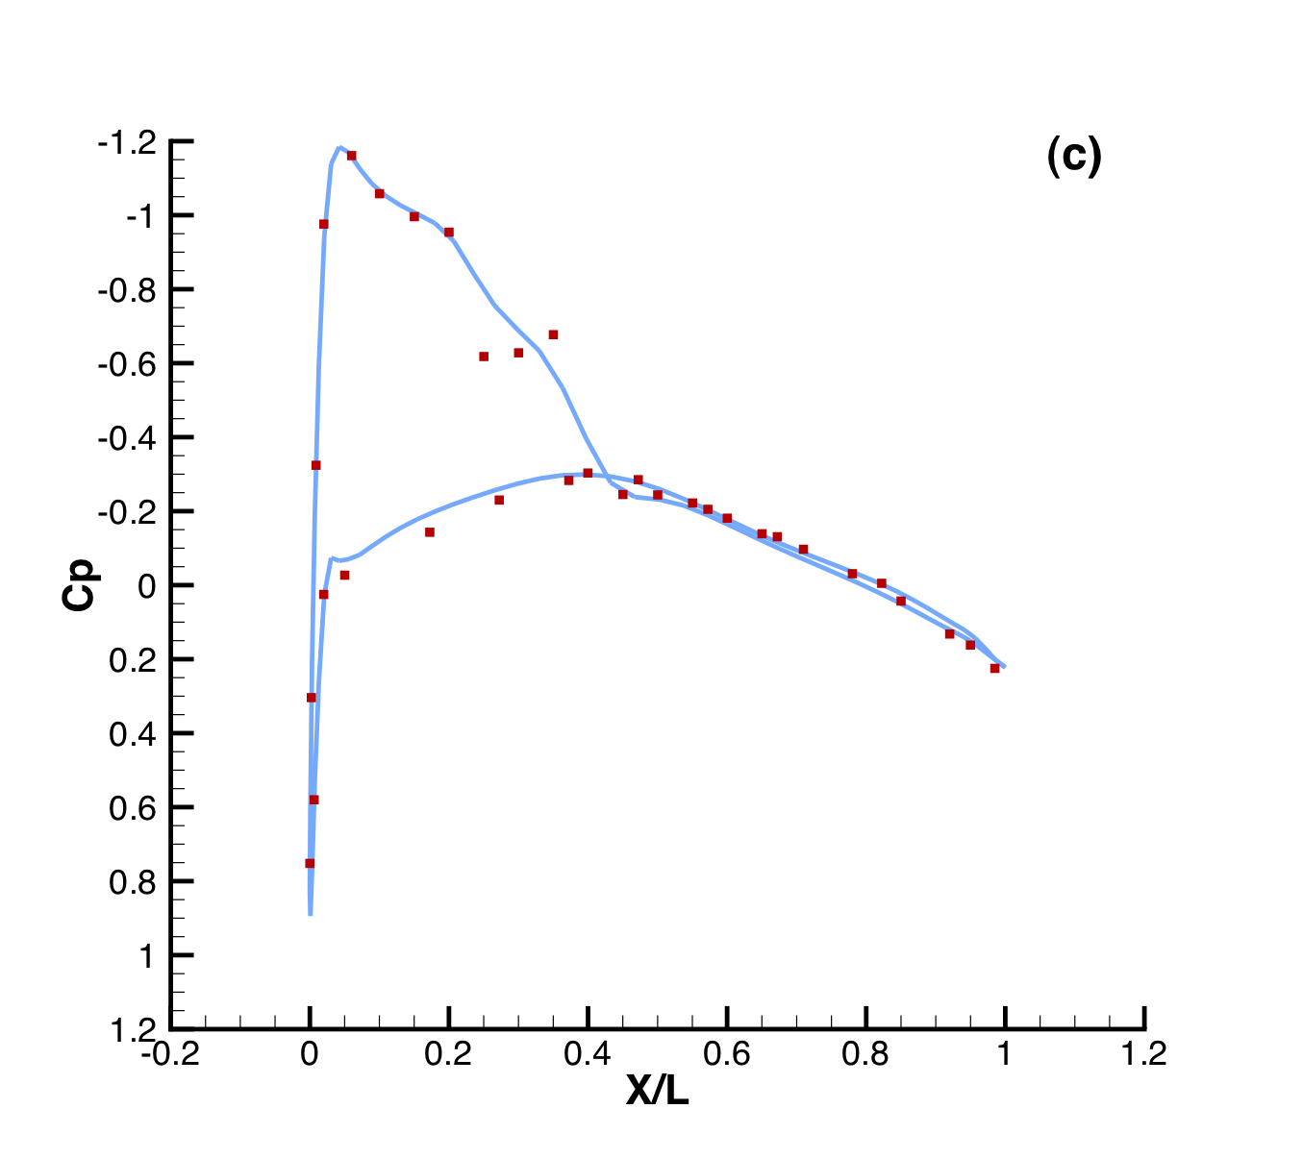
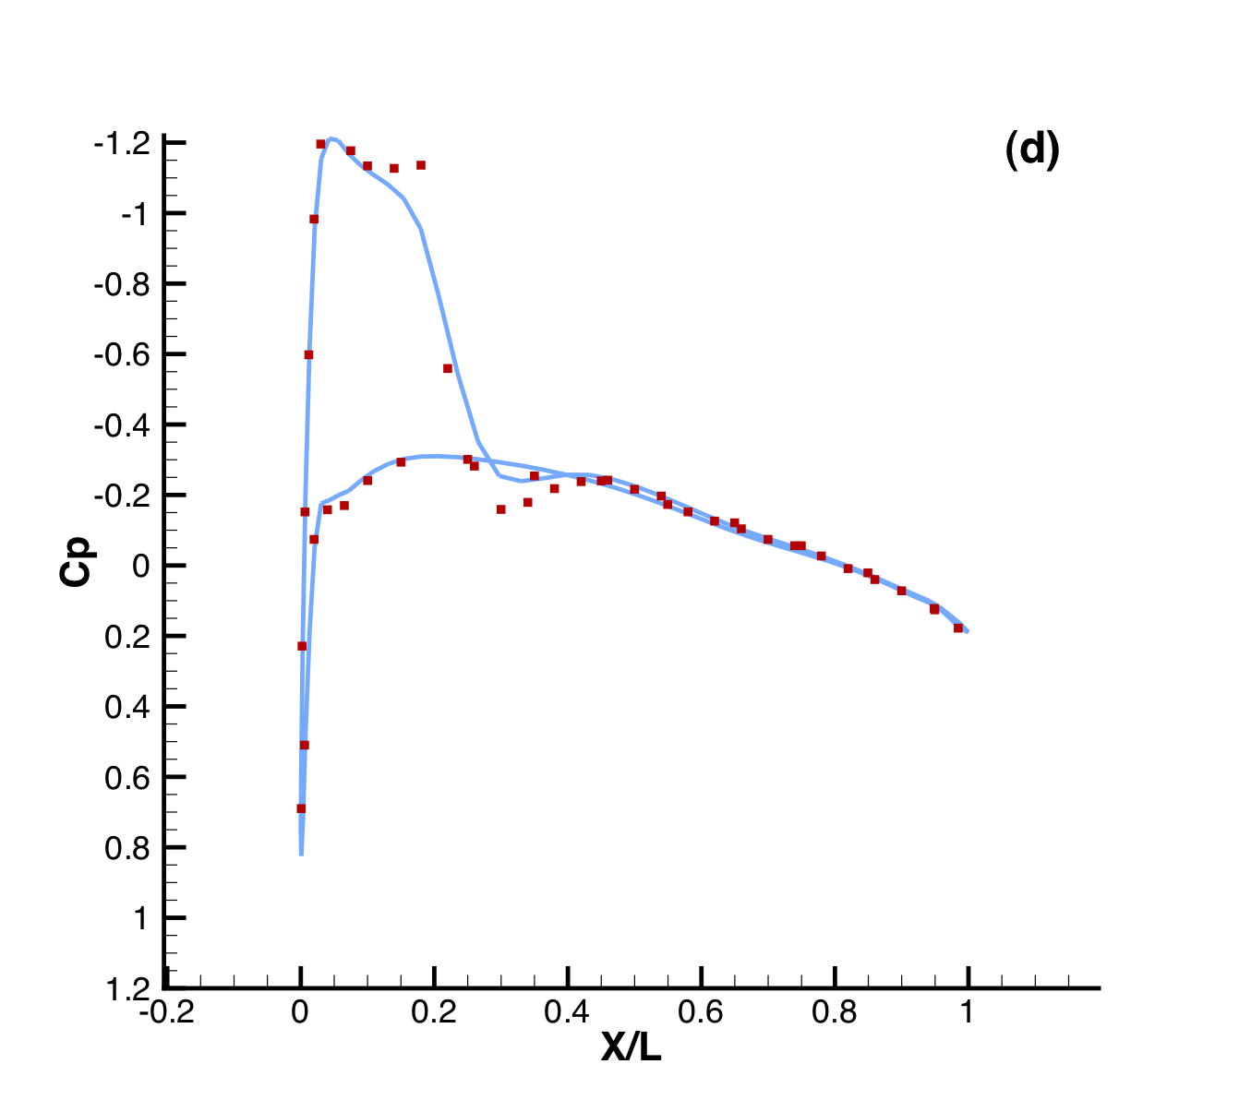
ONERA M6 RANS Analysis
Prepare geometry & mesh beforehand.
Choose appropriate physics.
Set proper conditions for a viscous simulation.
Select numerical methods:
Convective terms
Viscous terms
Time Integration
Multi-grid
Run the analysis.
Post-process the results.
Comparison of Cp profiles of the experimental results of Schmitt and Carpin (red squares) against SU2 computational results (blue line) at different sections along the span of the wing. (a) y/b = 0.2, (b) y/b = 0.65, (c) y/b = 0.8, (d) y/b = 0.95

Slide 12
ONERA M6 RANS Analysis
DEMO

